Slide 1
Course Title: Programming Language I
Course Code: CSE110
Semester: Fall 2022

Slide 2
Type Conversion in Python (Casting)
input() function always returns a string. If you want a numeric type, then you need to convert the string to the appropriate type with int(), float() or str() which are built in functions.
int() - constructs an integer number from an integer literal or a float literal or a string literal
float() - constructs a float number from an integer literal or a float literal or a string literal
str() - constructs a string from a wide variety of data types including strings, integer literals and float literals

Slide 3
Type Conversion in Python (Casting)
Examples:
w = int(4) # output will be 4
x = int(6.89) # output will be 6
y = int(‘5’) # output will be 5
z = float(3.49) # output will be 3.49
m = float(4) # output will be 4.0
n = float(‘4.8’) # output will be 4.8
p = str(12.5) # output will be ‘12.5’

Slide 4
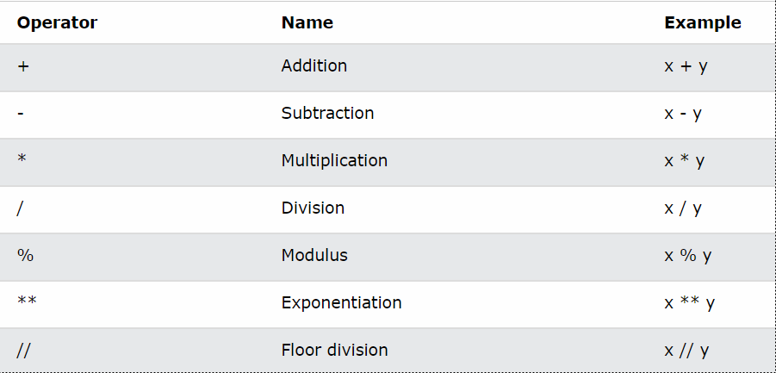
Introduction to Operators
Arithmetic Operators

Slide 5
Arithmetic Operators
Addition: Add values on either side of the operator
>>> x = 5
>>> y = 6
>>> print(x+y)
Output = 11
Subtraction: Subtract right hand operand from left hand operand
>>> x = 8
>>> y = 6
>>> print(x-y)
Output = 2

Slide 6
Arithmetic Operators
Multiplication: Multiply values on either side of the operator
>>> x = 5
>>> y = 6
>>> print(x*y)
Output = 30
Division: Divide left hand operand by right hand operand
>>> x = 10
>>> y = 2
>>> print(x/y)
Output = 5.0 (Always a float type value)

Slide 7
Arithmetic Operators
Modulus: Also known as remainder operator
>>> x = 10 >>> x = 3
>>> y = 2 >>> y = 4
>>> print(x%y) >>> print(x%y)
Output = 0 Output = 3
Exponentiation: Perform exponential (power) calculations on operators
>>> x = 2
>>> y = 3
>>> print(x**y)
Output = 8

Slide 8
Arithmetic Operators
Floor Division: The real floor division operator is //. It returns floor value for both integer and floating point arguments.
Floor division always show the least value of the result.
>>> 5//2 = 2
>>> -5//2 = -3
>>> 3.0//3 = 1.0
>>> -5.0//2 = -3.0

Slide 9
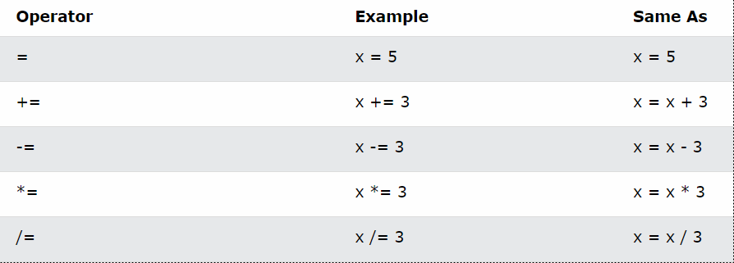
Assignment Operators

Slide 10
Assignment Operators
(=): Assigns the value found on the right operand to the left operand
>>> x = 5
(+=): Adds the value found in the right operand to the value found in the left operand
>>> x = 5
>>> x+=3
>>> print(x)
Output = 8
(-=): Subtracts the value of the right operand from the value of the left operand
>>> x = 8
>>> x -=3
>>> print(x)
Output = 5

Slide 11
Assignment Operators
(*=): Multiplies the value of the right operand by the value of the left operand
>>> x = 5
>>> x*=3
>>> print(x)
Output = 15
(/=): Divides the value of the left operand by the value of the right operand
>>> x = 6
>>> x/=3
>>> print(x)
Output = 2

Slide 12
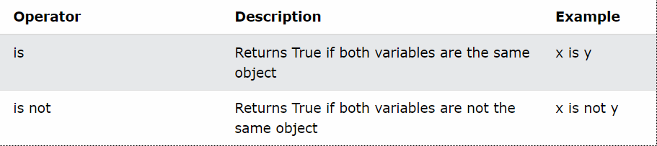
Identity Operators
It only works for integer value.

Slide 13
Identity Operators
is:
>>> x = 10 >>> x = 10
>>> y = 10 >>> y = ‘10’
>>> print(x is y) >>> print(x is y)
Output = True Output = False
is not:
>>> x = 10 >>> x = 15
>>> y = ‘10’ >>> y = ‘Hello’
>>> print(x is not y) >>> print(x is not y)
Output = True Output = True

Slide 14
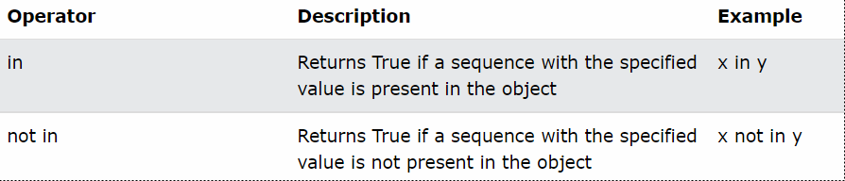
Python Membership Operators

Slide 15
Membership Operators
in:
x = [‘cat’,’dog’] x = ‘Hello’
print(‘rat’ in x) print(‘H’ in x)
Output = False Output = True
not in:
x = ‘Hello’ x = [‘cat’, ‘dog’]
print(‘W’ not in x) print(‘cat’ not in x)
Output = True Output = False

Slide 16
Logical Operators
and (Logical AND)
or (Logical OR)
not (Logical NOT)
Comparison/ Relational Operators
== (equal)
!= (not equal)
> (greater than)
< (less than)
>= (greater than or equal)
<= (less than or equal)

Slide 17
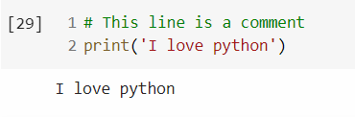

Comments in Python
Comments can be used to explain Python code.
Makes the code more readable.
Comments starts with a #
Example:

Slide 18
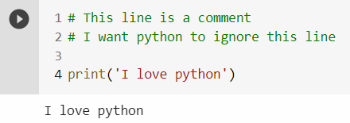
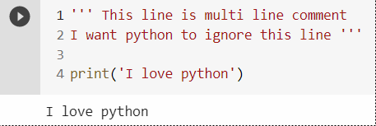
Multi Line Comments
To add a multiline comment you could insert a # for each line:
You can also use a multi line string by using triple quotes

